Slide 1
op1
op2
Component
Executor
Thread
Running
Passive
Component
Dispatcher
Thread
Running
Dispatch (op2)
Passive
Complete
{op2.Total_Execution_Time < op2.Deadline}
Component
Operation
Lifecycle
[op2]
Running
Ready &
Waiting
Enqueue (op2)
0
10
16
Time

Slide 2
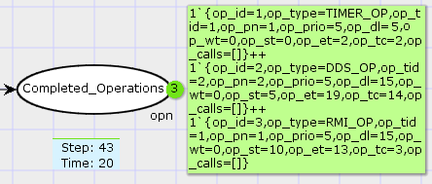
COMPONENT OPERATION | START TIME [Time-stamp] | END TIME [Time-stamp] | DEADLINE [Ticks]
TIMER_OP [on Sensor] | 0 | 2 | 5
DDS_OP [on Trajectory Planner] | 5 | 19 | 15
RMI_OP [on Sensor] | 10 | 13 | 15

Slide 3
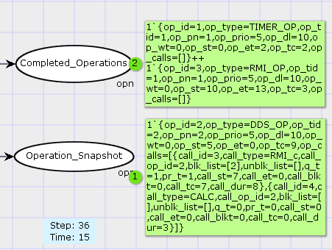

Slide 4
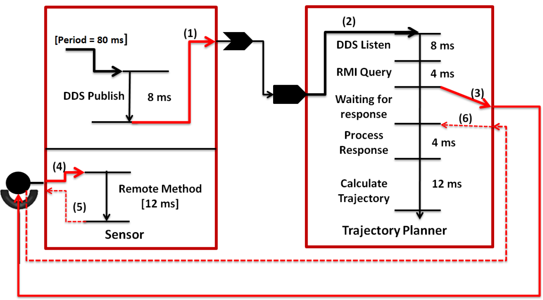
Timer Expiry
Subscriber Callback
Remote Operation

